Slide 1
Java Lecture 11

Slide 2
Exception Handling
Errors :
  Compile time/Syntax Error:
  Eg:
    Syntax missing, using undeclared variable etc.
  Runtime Error:
  Eg:
    Division by Zero, Array index out of bound etc.

Slide 3
Exception Handling
Runtime Error:
  Runtime error results in an Exception.
  Whenever Exception occurs java creates an object of Exception or its derived class.
  Exception leads to abnormal termination of program giving some garbage value on screen.
  Handling Exception means aware of the runtime error and perform right operation when it occur.

Slide 4
Exception Handling
For Exception Handling Java provide:
  Constructs:
    try
    catch
    finally
  Statements;
    throw
    throws

Slide 5
Exception Handling
try:
  All statements that may results in the an error are written within try.
  A method can have nested or multiple try blocks.
catch:
  Every “try” should be followed by at least one catch block.
  Multiple catch block works like cases in switch only one will be executed depending on Exception generated.

Slide 6
Exception Handling
catch:
  catch receive an argument of Exception or its derived class.
finally:
  finally can be used as a substitute or along with catch .
  There can be only one finally .
  finally does not receive any arguments.
  finally is unconditional and catch is conditional.
  Code in the finally always executes if exception occurs.

Slide 7
Exception Handling
throw:
  It is used to generate an Exception
throws:
  It is used to forward an Exception.
Note:
  Exception is handled in the application development process.
  Exception is forwarded in the library development process.

Slide 8
Exception Handling
Syntax:
    try {
    <code to be monitored for exceptions>
    } catch (<ExceptionType1> <ObjName>) {
    <handler if ExceptionType1 occurs>
    }
    ...
    } catch (<ExceptionTypeN> <ObjName>) {
    <handler if ExceptionTypeN occurs>
    }

Slide 9
Exception Handling
Catch multiple Exception:
    class MultipleCatch {
    public static void main(String args[]) {
    try {
    int den = Integer.parseInt(args[0]);
    System.out.println(3/den);
    } catch (ArithmeticException exc) {
    System.out.println(“Divisor was 0.”);
    } catch (ArrayIndexOutOfBoundsException exc2) {
    System.out.println(“Missing argument.”);
    }
    System.out.println(“After exception.”);
    }
    }

Slide 10
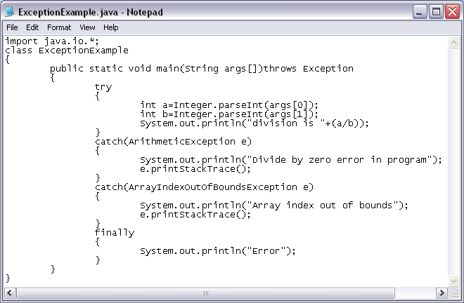

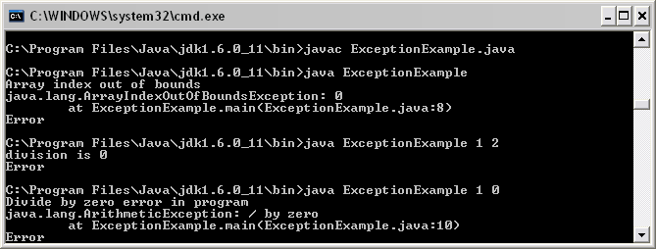
Exception Handling

Slide 11
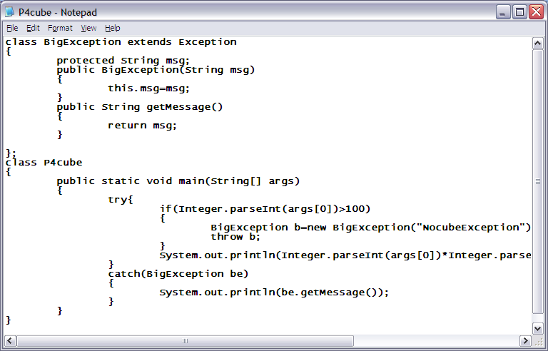
Exception Handling

Slide 12
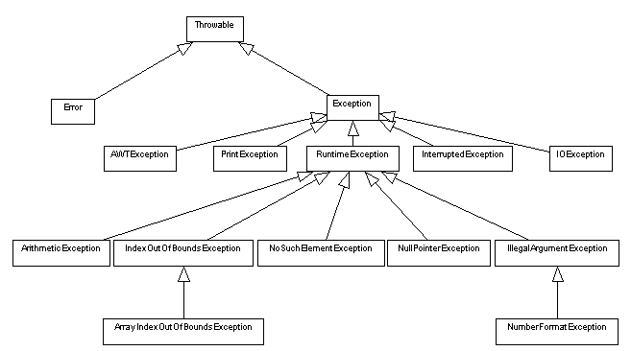
Exception Handling
Exception Hierarchy

Slide 13
Interface
Interface is the collection of method declaration(prototype)
If any class implements an interface .it provide definition for the methods declared in interface
A class can implement one or more interface
A part from interface methods class can have its own methods
Save program with the interface name

Slide 14
Interface
Syntax:
  interface ABC{ public void A();}
  class XYZ implements ABC
  {
  public void A()
  {…….}
  }
  Interface BCD{public void b();}
  Class YZA implements ABC,BCD
  {
  public void A(){…….}
  public void B(){…….}
  public void C(){…….}
  }

Slide 15
What are Assertions
Allow the programmer to find out if the program
behaves as expected
Informs the person reading the code that a
particular condition should always be satisfied
Running the program informs you if assertions made are
true or not
If an assertion is not true, an AssertionError is thrown
User has the option to turn it off or on when running
the application

Slide 16
Enabling or Disabling Assertions
Program with assertions may not work properly if
used by clients not aware that assertions were
used in the code
Enabling assertions:
– Use the –enableassertions or –ea switch.
java –enableassertions MyProgram

Slide 17
Assert Syntax
Two forms:
– Simpler form:
assert <expression1>;
where
<expression1> is the condition asserted to be true
– Other form:
assert <expression1> : <expression2>;
Where
<expression1> is the condition asserted to be true
<expression2> is some information helpful in diagnosing why the statement failed

Slide 18
Assert Example
1 class AgeAssert {
2 public static void main(String args[]) {
3 int age = Integer.parseInt(args[0]);
4 assert(age>0);
5 /* if age is valid (i.e., age>0) */
6 if (age >= 18) {
7 System.out.println(“You're an adult! =)”);
8 }
9 }
10 }

